Slide 1
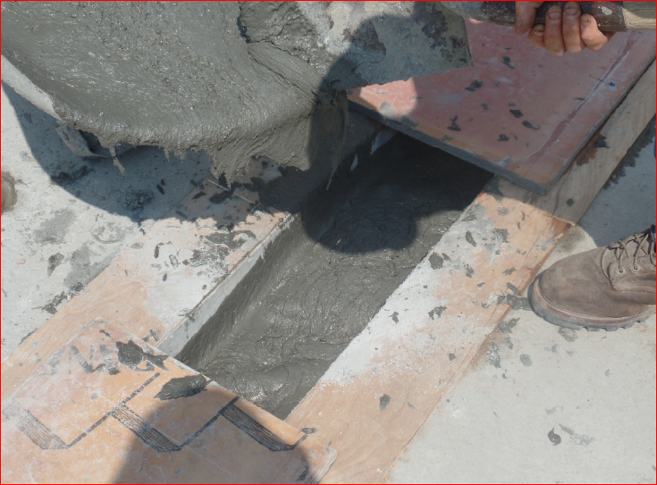
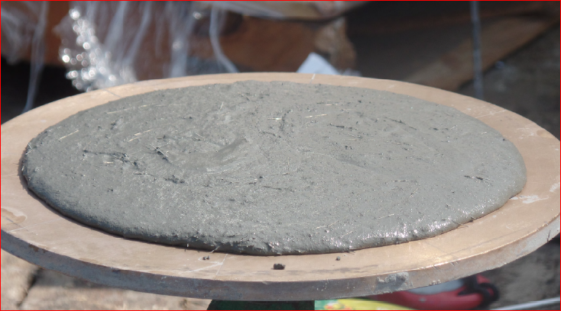
 | FACT SHEET
 | Ultra High Performance Concrete (UHPC)
& STIC Annual Meeting
STIC PROJECT TITLE Ultra High Performance Concrete (UHPC) STUDY TIMELINE July 2016 PRINCIPAL CHAMPION Ben Graybeal, FHWA VTRANS CONTACT Rob Young, Structures MORE INFORMATION https://www.fhwa.dot.gov/innovation/everydaycounts/edc_4/uhpc.cfm This fact sheet was prepared for the 2017 VTrans Research Symposium & STIC Annual Meeting held on September 28, 2017 at National Life in Montpelier, VT. 8:00 am– 12:00 pm. Fact sheets can be found for additional projects featured at the 2017 Symposium at http://vtrans.vermont.gov/planning/research/2017symposium Additional information about the VTrans Research Program can be found at http://vtrans.vermont.gov/planning/research Additional information about the VTrans STIC Program can be found at http://vtrans.vermont.gov/boards-councils/stic | Project Description First use of UHPC on Bridge Project in Waitsfield, Vt. Methodology Closure pour for precast concrete approach slab longitudinal joint. Conclusion Material installation was a success, but cost was much higher than expected. Non-proprietary equivalent could broaden its use. Benefits to Vtrans Higher Compressive Strength: UHPC compressive resistance is 6 to 8 times greater than conventional concrete reducing the length of reinforcing lap lengths, and the size of closure pours required during construction. Higher Tensile Strength & Ductility: UHPC contains metal fibers that make it ductile. With a strength 10 times higher than traditional concretes, it can resist bending and can withstand major transformations (such as pressure or dilation) without breaking. Sources of the steel fibers are available in the U.S. Increased Durability & Long Term Stability: With UHPC’s resistance to external aggressions such as abrasion, pollution, weathering and scratching, its longevity is 2 to 3 times longer than that of conventional concrete.
2017 Research
Symposium

